Slide 1

Sentiment Analysis of Amazon Fine Food Reviews using Machine Learning
Internship Project | Prajyot Datta Padol | 31st January 2026

Slide 2

INTRODUCTION
Understanding Sentiment Analysis
Sentiment analysis is a natural language processing technique that automatically identifies and extracts emotional tone from text data. It enables businesses to understand customer opinions at scale.
For e-commerce platforms, analysing product reviews helps companies gauge customer satisfaction, identify product issues early, and make data-driven decisions to improve offerings and customer experience.

Slide 3
PROBLEM STATEMENT
Automating Review Classification
Objective
Categories
Challenge
Automatically classify product reviews into sentiment categories without manual intervention
Three sentiment classes: Positive, Neutral, and Negative
Process thousands of reviews efficiently whilst maintaining high classification accuracy
Manual review analysis is time-consuming and subjective. Machine learning offers a scalable, consistent approach to understanding customer sentiment across large datasets.

Slide 4
DATA
Amazon Fine Food Reviews Dataset
Dataset Overview
Why This Dataset?
Real-world customer reviews from Amazon's Fine Food category
The Amazon Fine Food Reviews dataset provides genuine customer feedback with associated numerical ratings, making it ideal for supervised learning.
Review text (written feedback)
Score ratings (1-5 stars)
Authentic customer opinions
Reviews span various food products, offering diverse language patterns and sentiment expressions typical of e-commerce platforms.

Slide 5
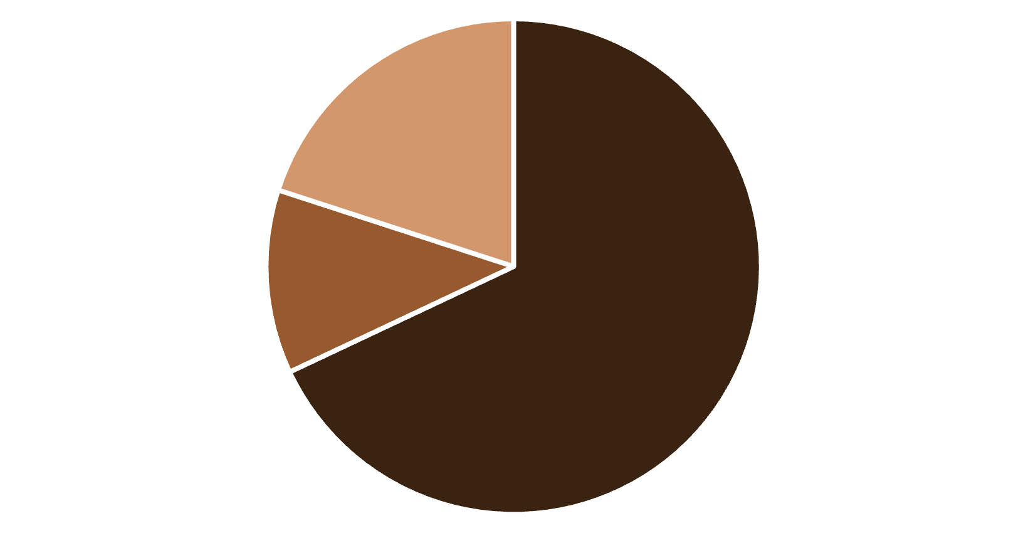
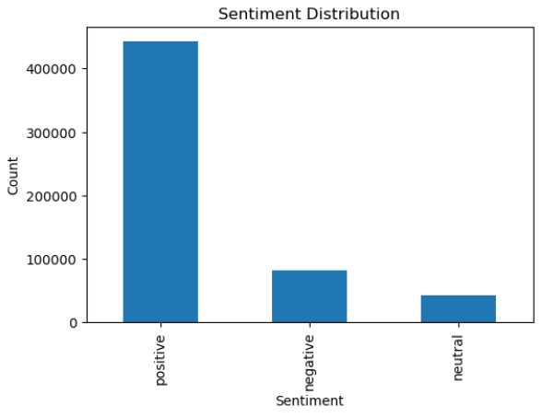
ANALYSIS
Exploratory Data Analysis
Key Findings
The dataset exhibits a significant class imbalance, with the majority of reviews expressing positive sentiment.
This distribution reflects typical e-commerce patterns where satisfied customers are more likely to leave reviews. However, this imbalance presents challenges for model training, particularly in accurately identifying neutral and negative sentiments.
The dataset is highly imbalanced, with positive reviews dominating. This affects the model learning and makes neutral and negative sentiment harder to classify.
Positive
Neutral
Negative

Slide 6




PREPROCESSING
Text Preprocessing Pipeline
Lowercasing
Character Removal
Convert all text to lowercase for consistency
Remove special characters and punctuation
Stopword Removal
Clean Text
Eliminate common words using scikit-learn
Output ready for feature extraction
Text preprocessing standardises review text and removes noise, ensuring that machine learning models focus on meaningful sentiment-bearing words rather than formatting variations or common filler words.

Slide 7
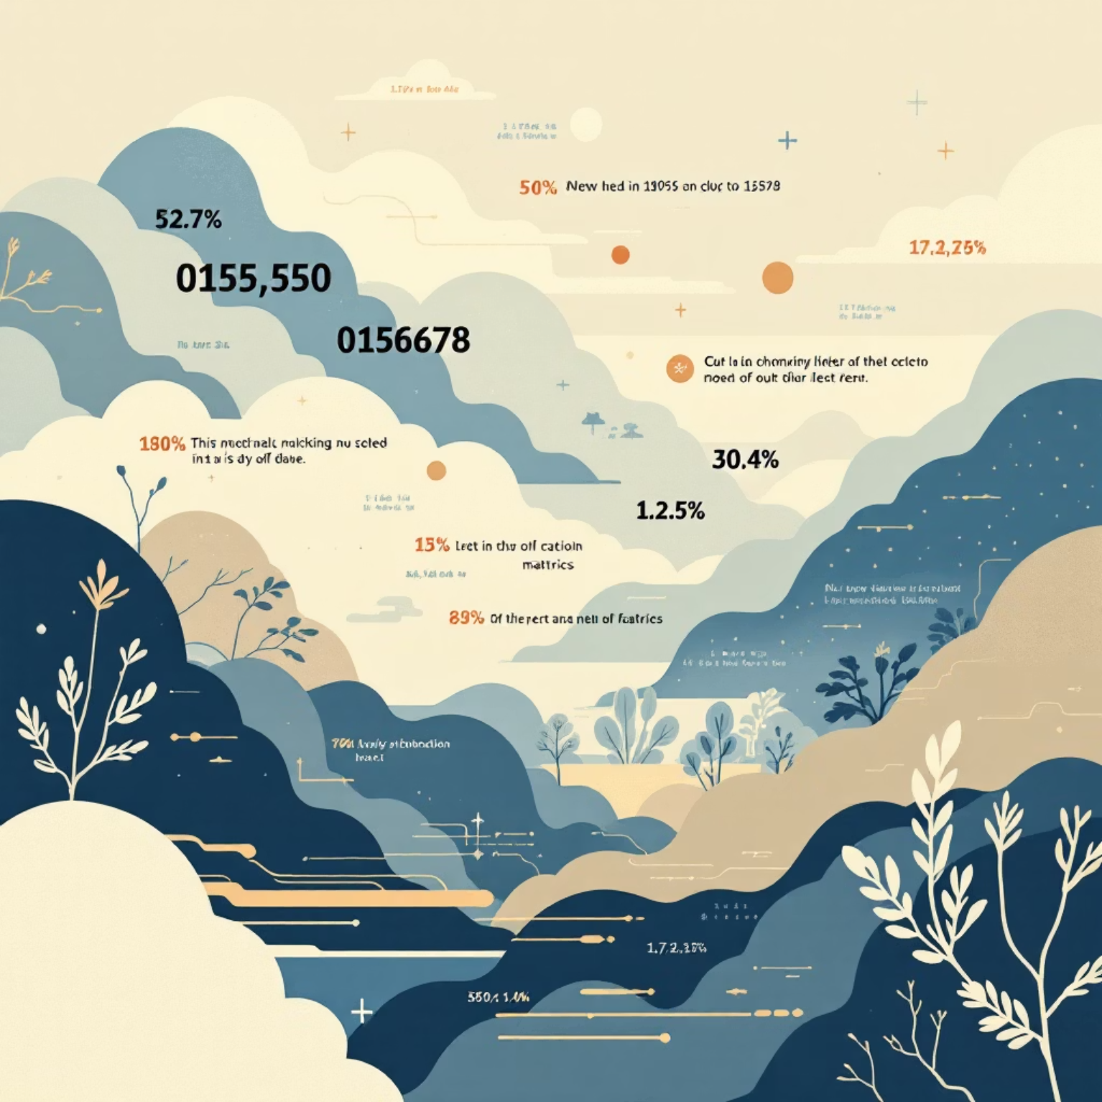
FEATURES
Feature Extraction with TF-IDF
Converting Text to Numbers
TF-IDF (Term Frequency–Inverse Document Frequency) transforms text into numerical features that machine learning algorithms can process.
It weighs words by their importance: frequent terms in a document but rare across all documents receive higher scores, capturing distinctive sentiment indicators.
This vectorisation enables mathematical operations whilst preserving semantic meaning.

Slide 8
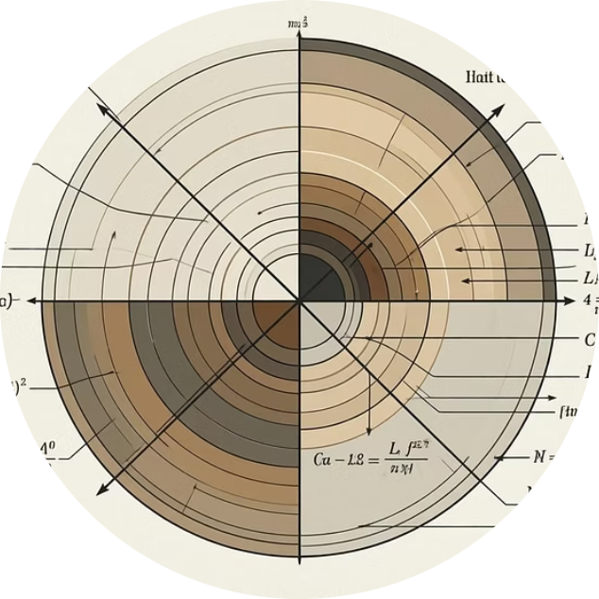
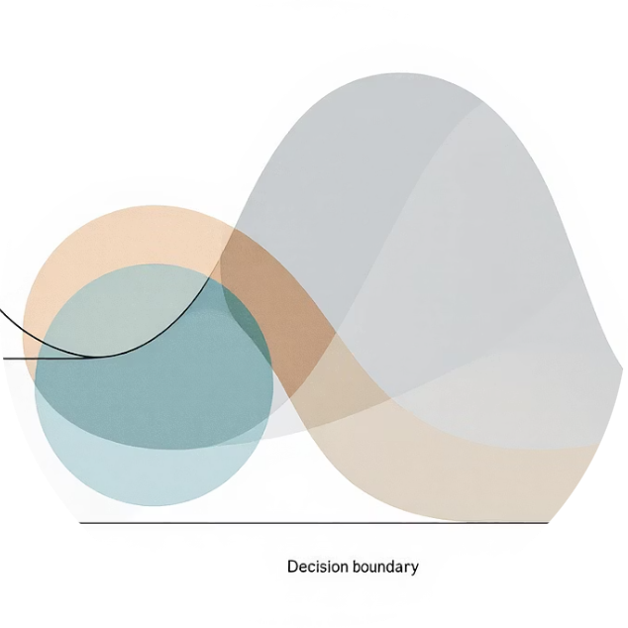

MODELLING
Machine Learning Models Evaluated
Naive Bayes
Logistic Regression
Support Vector Machine
Probabilistic classifier based on Bayes' theorem, efficient for text classification
Linear model that estimates probability of sentiment classes
Finds optimal decision boundary to separate sentiment classes

Slide 9
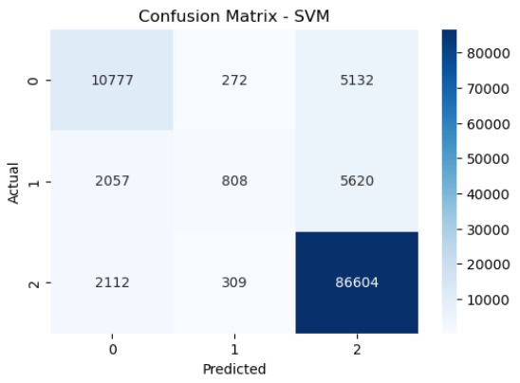
RESULTS
Model Performance Evaluation
SVM Achieved Highest Accuracy
The Support Vector Machine model demonstrated superior performance across all sentiment classes, particularly excelling at identifying positive reviews.
The confusion matrix reveals strong diagonal values, indicating correct classifications. However, neutral reviews proved more challenging due to their subtle linguistic characteristics and smaller sample size in the training data.

Slide 10
CONCLUSION & FUTURE WORK
Project Outcomes and Next Steps
Conclusion
Future Scope
Successfully implemented sentiment analysis pipeline with SVM selected as the final model
Address class imbalance using SMOTE or weighted loss functions
Explore deep learning models (LSTM, BERT) for improved accuracy
Deploy as a web application for real-time sentiment analysis
Achieved reliable classification of customer reviews into positive, neutral, and negative sentiments

